Slide 1
Higher Biology
Evolution
Mr G R Davidson

Slide 2
Inheritance
Evolution is the gradual change in the characteristics of a population resulting from the selected alleles.
Evolution occurs over many many generations.
Alleles are selected based on their usefulness.

Slide 3
Inheritance
Vertical inheritance is the passing of genetic material from parents to offspring.
In sexual reproduction, this mixes the genetic material of both parents and creates further variation.
This can be represented in a family tree diagram.

Slide 4
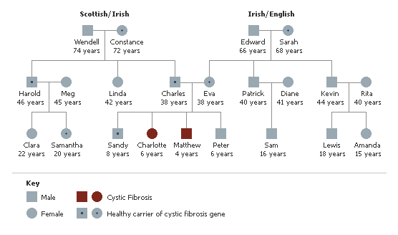
Inheritance

Slide 5
Inheritance
Asexual reproduction is much quicker than sexual reproduction.
However, the genetic material being passed on is identical and therefore, there is no variation.

Slide 6
Inheritance
Prokaryotes can transfer genetic material horizontally, i.e. from one organism to another.
This also promotes variation.
This horizontal transfer happens within a population, but it can also happen between different species.

Slide 7
Horizontal Genetic Transfer
Bacteria A
Bacteria B
Plasmid

Slide 8
Horizontal Genetic Transfer
Bacteria A
Bacteria B
The plasmid is copied
and it then travels
through the conjugation
tube to the other
cell.
Conjugation tube

Slide 9
Horizontal Genetic Transfer
Bacteria A
Bacteria B

Slide 10
Selection
Selection is the process where some genes in a population increase in frequency because they are favourable.
Other genes are not selected and so their frequency decreases.
This is a non-random process.

Slide 11
Natural Selection
Natural selection was first put forward by Charles Darwin.
It suggested that:
More offspring are produced than the environment is able to support.
This leads to a struggle for survival brought about by selection pressures like food shortage, poor disease resistance, etc..

Slide 12
Natural Selection
Because the offspring show variation and are all slightly different, those better adapted to the environment will survive to reproduce and so pass on these favourable genes.
Those not so well adapted don’t survive and their genes are lost.
This results in certain genes increasing in their frequency, and is a non-random process.

Slide 13
Selection
Some DNA sequences are damaging and these are called deleterious.
These will eventually disappear from the population as their frequency decreases.
Some mutations can be lethal and will disappear much quicker.
This process of negative selection is also non-random.

Slide 14
Selection
Since females produce very few eggs, the females need to ensure that her offspring have the greatest survival chances.
This sexual selection operates in two ways:

Slide 15
Selection
Male to male competition.
Males compete fiercely with each other over females and space.
In this way, only the more dominant males get to reproduce and pass their genes on, e.g. red deer.
Female Choice
The females have to choose a male based on the traits he possesses and displays, e.g. peacocks.

Slide 16
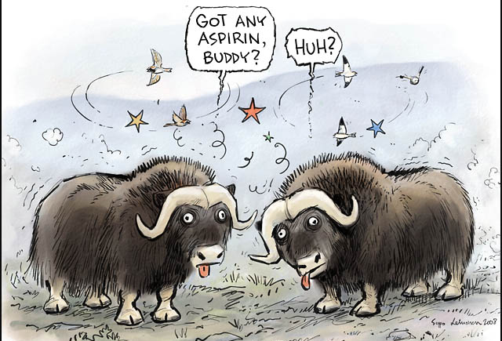
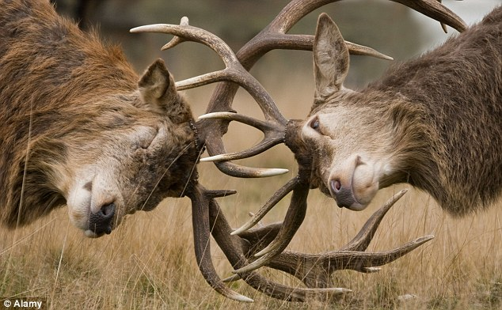
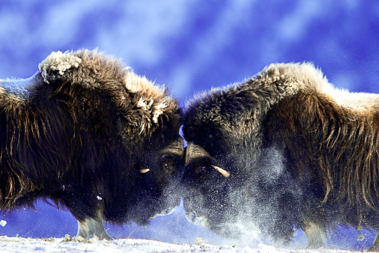
Selection
Male to Male Competition

Slide 17
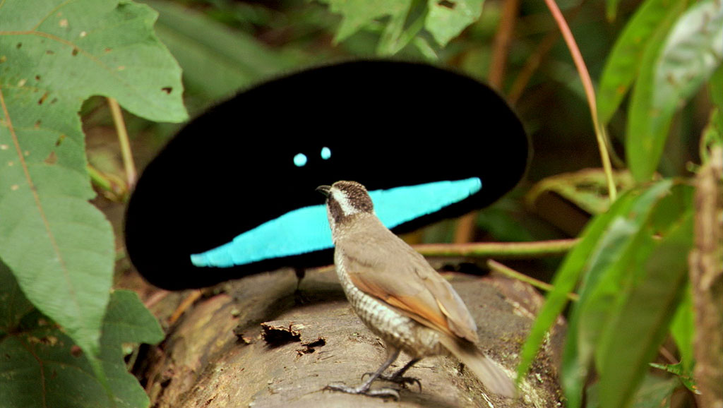
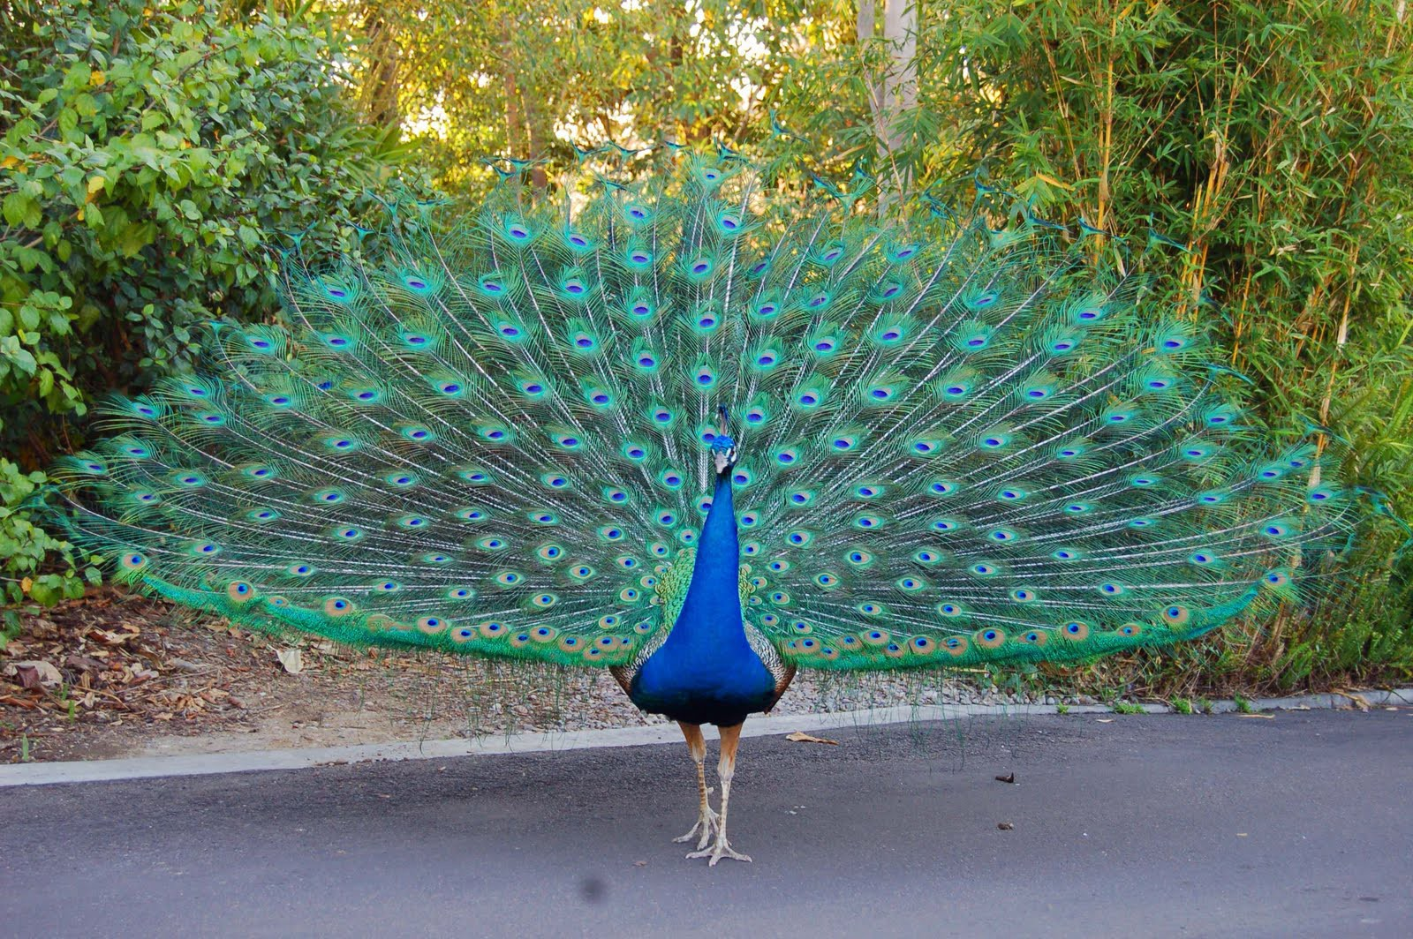
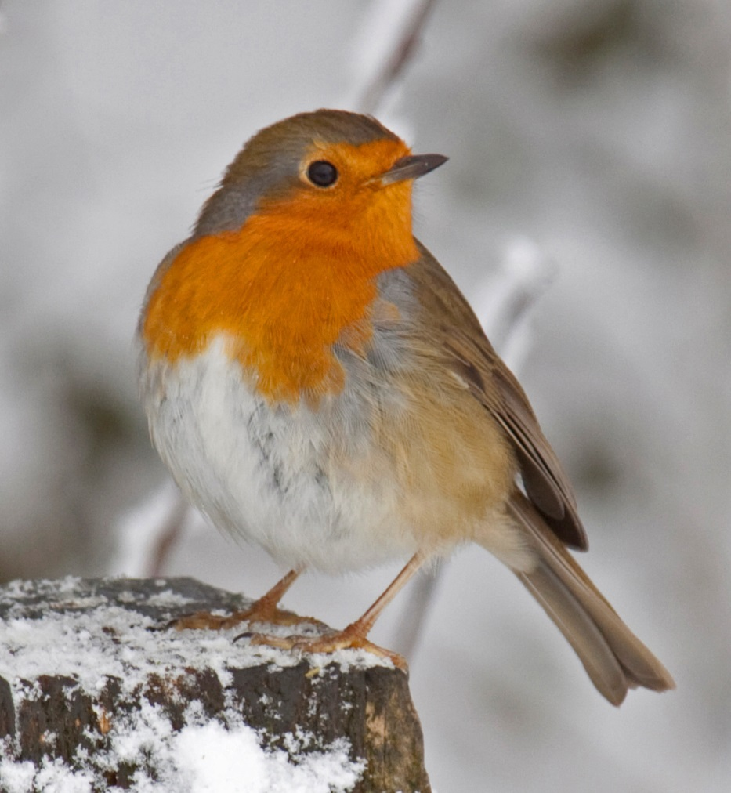
Selection
Female Choice

Slide 18
Stabilising Selection
This type of selection puts pressures on the extremes of a range.
The mean value doesn’t change but the genetic diversity decreases.
Examples include human babies.
Babies born with a very low birth weight are more likely to develop life threatening conditions and those with a high birth weight are more likely to have difficulties during the birth process.

Slide 19
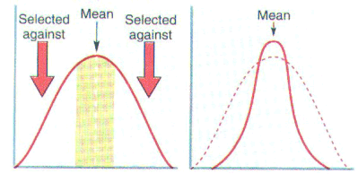
Stabilising Selection

Slide 20
Directional Selection
Directional selection tends to move the mean towards one of the extreme values.
It is usually brought about by a change in the environment which results in a progressive shift towards the extreme.
Examples include Industrial Melanism in the peppered moth.

Slide 21
Industrial Melanism
One of the most well researched examples of evidence for natural selection is that of Biston betularia – the peppered moth.
This moth, which is common in England, normally rests on trunks and branches of trees.

Slide 22
Industrial Melanism
One form of it is a light colour, but since 1848, melanic (darker, with more melanin pigment) forms have been found, the first near Manchester.
As the moths are predated on by birds, the dark form survives better in polluted areas, while the light form survives better in non-polluted areas.
This shifts the mean value of the frequency of the alleles for the dark colour.

Slide 23
Industrial Melanism
1844 → mainly white moths
Industrial Revolution
1900 → less white moths – more dark moths
Clean air act
1950 → more white moths – less dark moths

Slide 24
Industrial Melanism
The reason white moths survive better in non-polluted areas is the presence of a light coloured lichen growing on trees providing the white moths with camouflage whereas dark moths are easily seen and eaten by the birds.
In heavily polluted areas, the soot kills the lichens and darkens the trees, giving camouflage to the dark moths and making the white moths susceptible to predation.

Slide 25
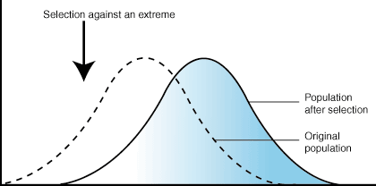
Directional Selection

Slide 26
Disruptive Selection
This type of selection involves the two extreme forms of a characteristic being favoured over the intermediate.
It results in 2 mean values and the population becoming split into 2 distinct groups.
Examples include body size in male salmon.

Slide 27
Disruptive Selection
In male salmon, the larger body sized fish compete better for territories.
The very small bodied males, however, have the ability to sneak into these territories and fertilise the eggs without being spotted.
This means that both groups get to pass on their genes, while the intermediate group don’t.

Slide 28
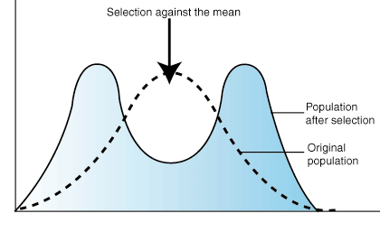
Disruptive Selection

Slide 29
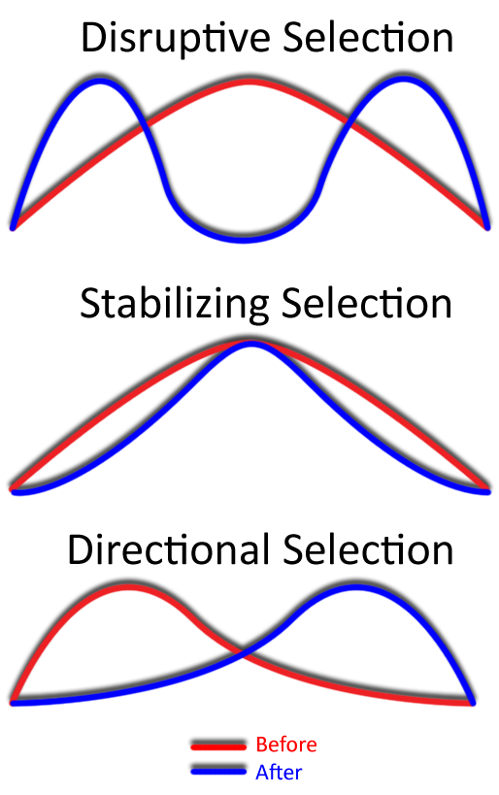
Selection Pressures (Summary)

Slide 30
Genetic Drift
The total number of gene sequences in a population is known as the gene pool.
In very large populations the gene frequency tends to remain fairly constant.
However, in much smaller populations, some alleles will increase in frequency while others will decrease.
This is called genetic drift.

Slide 31
Founder Effect
The founder effect is a special case of genetic drift.
If a small splinter group becomes separated from the main population, it will contain the same alleles as the main group but these may have different frequencies.

Slide 32
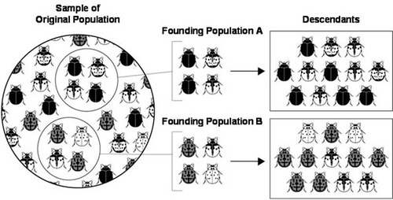
Founder Effect

Slide 33
Neutral Mutations
Most minor mutations don’t have any effect on how well an organism is adapted to its environment, and are thus termed neutral mutations.
However, several neutral mutations could become combined resulting in either an advantage or disadvantage to the organism.
These, however, are very rare.

Slide 34
Speciation
A species is a population of organisms which can breed together successfully and produce fertile offspring.
Differences between organisms are called variation.

Slide 35
Speciation
If variation between members of populations of the same species becomes great and the population becomes split into two or more separate units each with its own slightly different distribution of genes, then a new species may develop.
This is called speciation.
There are two types of speciation.

Slide 36
Allopatric Speciation
Allopatric speciation is brought about by geographical barriers preventing two populations of the same species from inter-breeding.
Barriers such as deserts, mountains, seas, etc..

Slide 37
Allopatric Speciation
Over a long period of time, the two groups evolve and become genetically different.
If this occurs to the point where they can no longer interbreed and produce fertile offspring, they are now two distinct species.

Slide 38
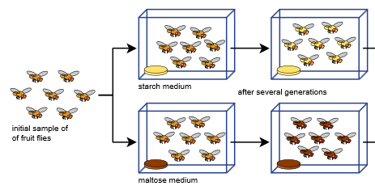
Allopatric Speciation

Slide 39
Sympatric Speciation
Sympatric speciation is a result of the gene flow being prevented, not by geographical barriers, but by ecological or behavioural barriers.
Ecological barriers such as the habitat changing and some individuals will adapt better to the new habitat while others will prefer the old one.
Behavioural barriers such as the different groups now having different reproductive times.

Slide 40
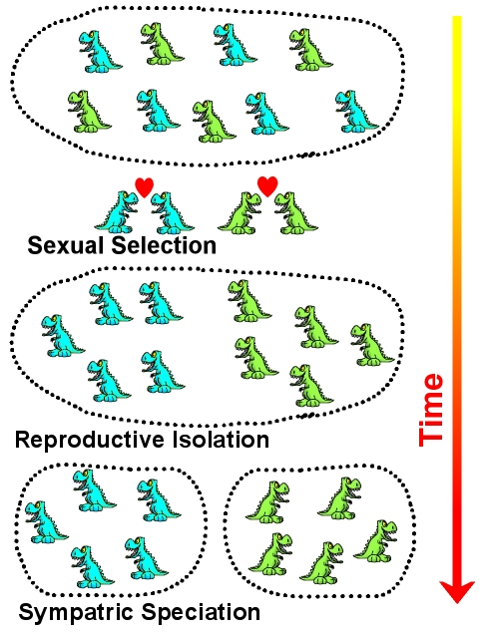
Sympatric Speciation

Slide 41
Hybrid Zone
A hybrid zone is an area where two populations meet.
They have the ability to interbreed and produce fertile offspring called hybrids.

Slide 42
Hybrid Zones
Population S
Population T
Population R
Hybrid zones

Slide 43
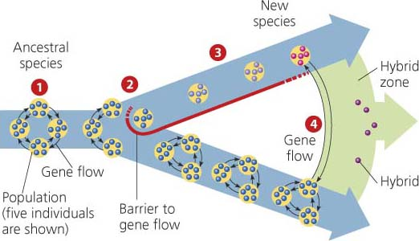
Hybrid Zones

